Slide 1
Convolutional Neural Networks
Slide courtesy: S. Lazebnik, D. Hoiem, Fei-Fei Li

Slide 2
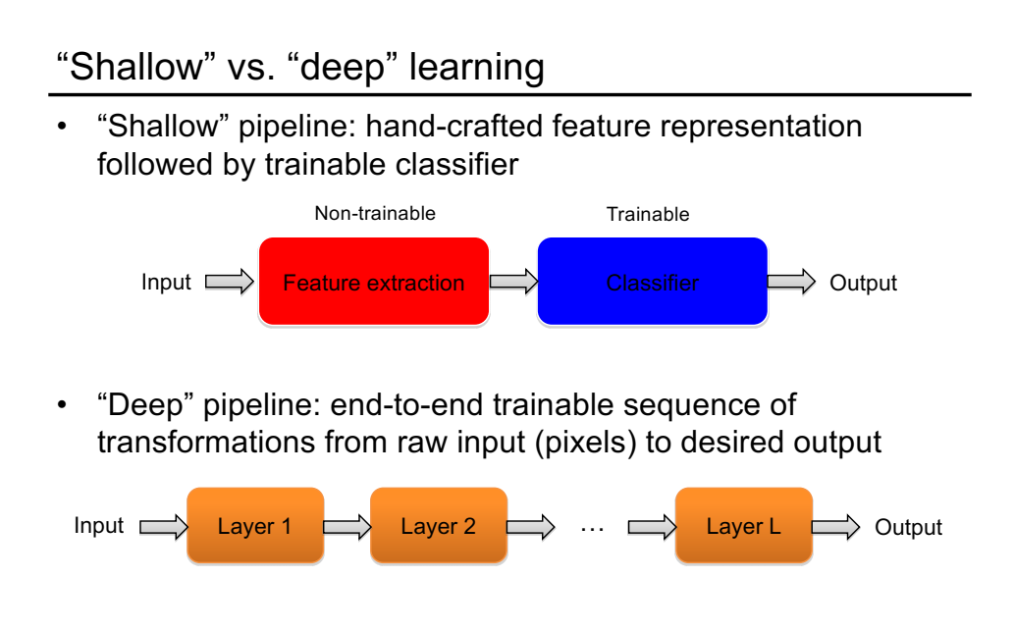

Slide 3
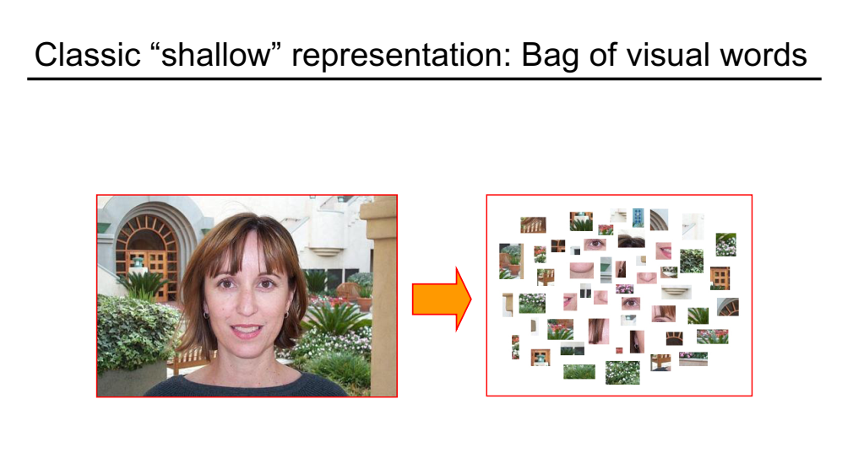

Slide 4
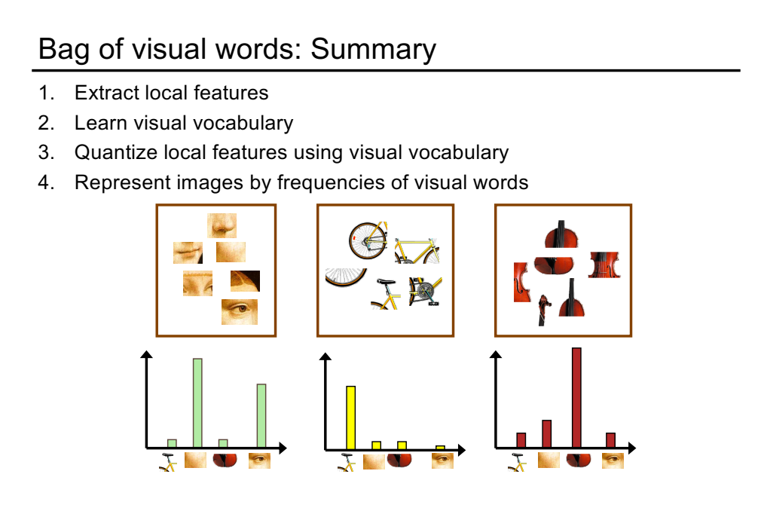

Slide 5
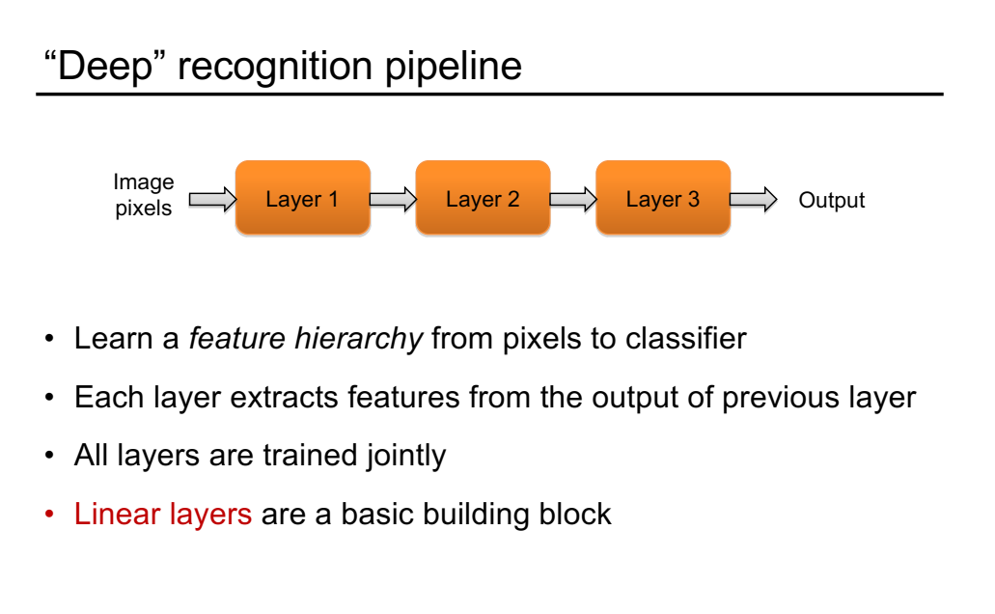

Slide 6
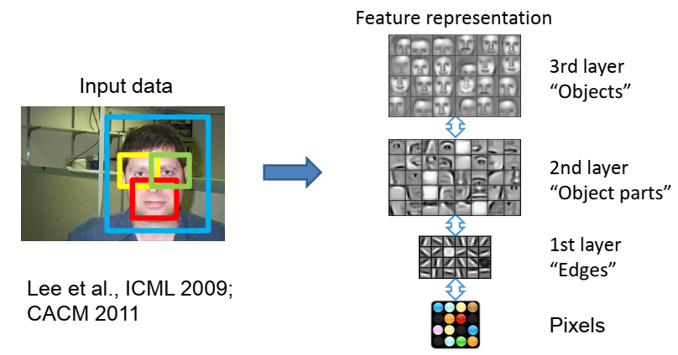
Learning Feature Hierarchy

Slide 8
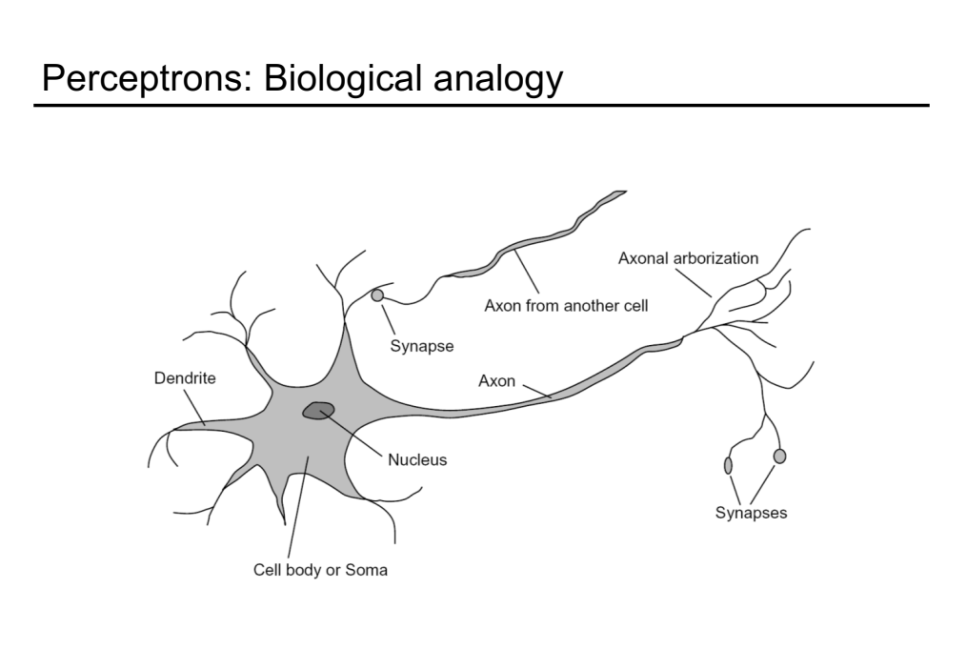

Slide 10
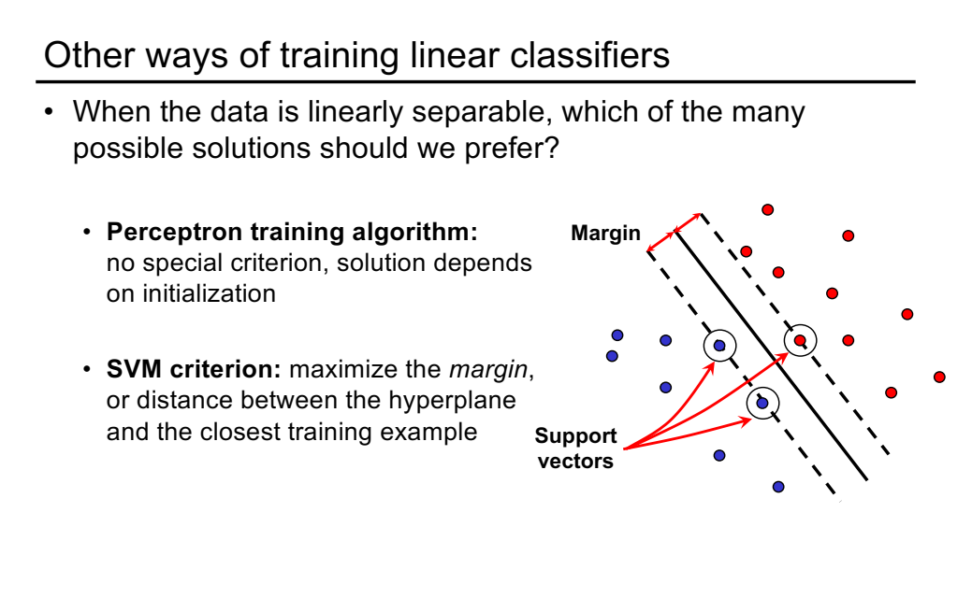

Slide 11

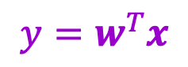
From linear classifiers to multi-layer networks
$$x$$
$$y=w^{T}x$$

Slide 12

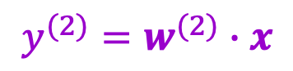
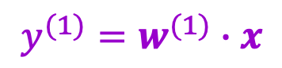
From linear classifiers to multi-layer networks
Linear layer
$$y^{(1)}=w^{(1)}∙x$$
$$y^{(2)}=w^{(2)}∙x$$
$$x$$
$$⋮$$

Slide 13
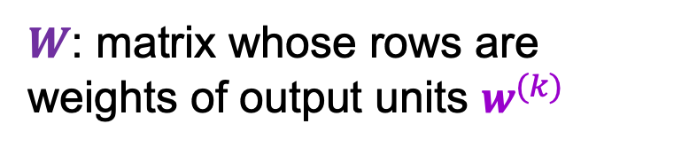
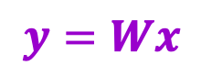
From linear classifiers to multi-layer networks
Linear layer
$$x$$
$$y=Wx$$
$W$: matrix whose rows are weights of output units $w^{(k)}$

Slide 14
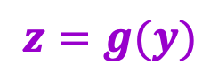
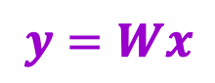

From linear classifiers to multi-layer networks
Linear layer
Nonlinearity
$$y$$
$$x$$
$$z=g(y)$$
$$y=Wx$$

Slide 15
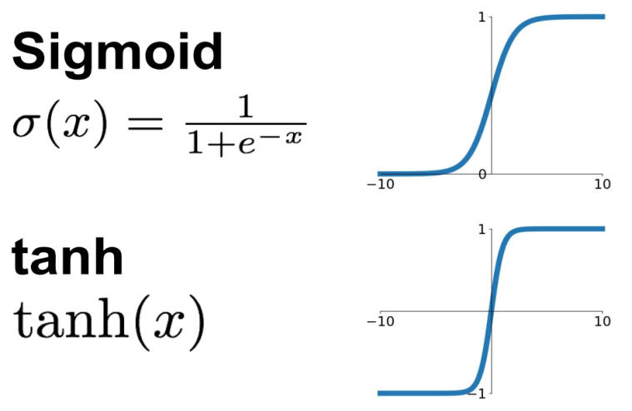
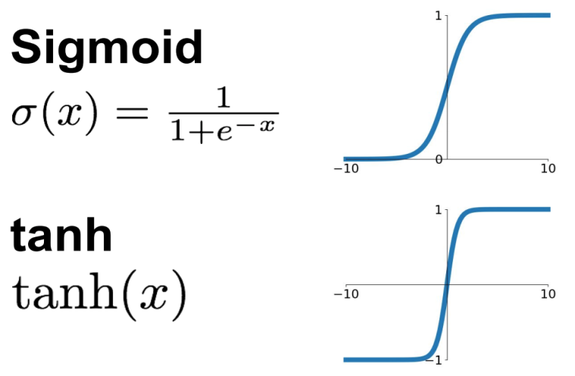
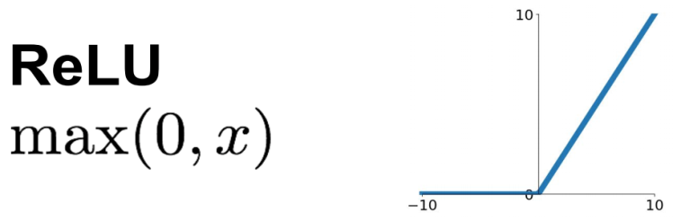
Common nonlinearities (or activation functions)
Source: Stanford 231n

Slide 16
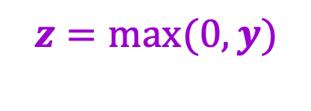
From linear classifiers to multi-layer networks
Linear layer
Nonlinearity
$$y$$
$$x$$
$$z=g(y)$$
…
Why do we need the nonlinearity?
$$y=Wx$$
$$z=max(0,y)$$

Slide 17

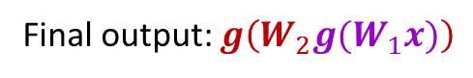
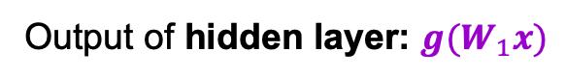
Two-layer neural network
Individual dimensions of $x$
Output of hidden layer: $g(W_{1}x)$
Final output: $g\left(W_{2}g(W_{1}x)\right)$

Slide 18
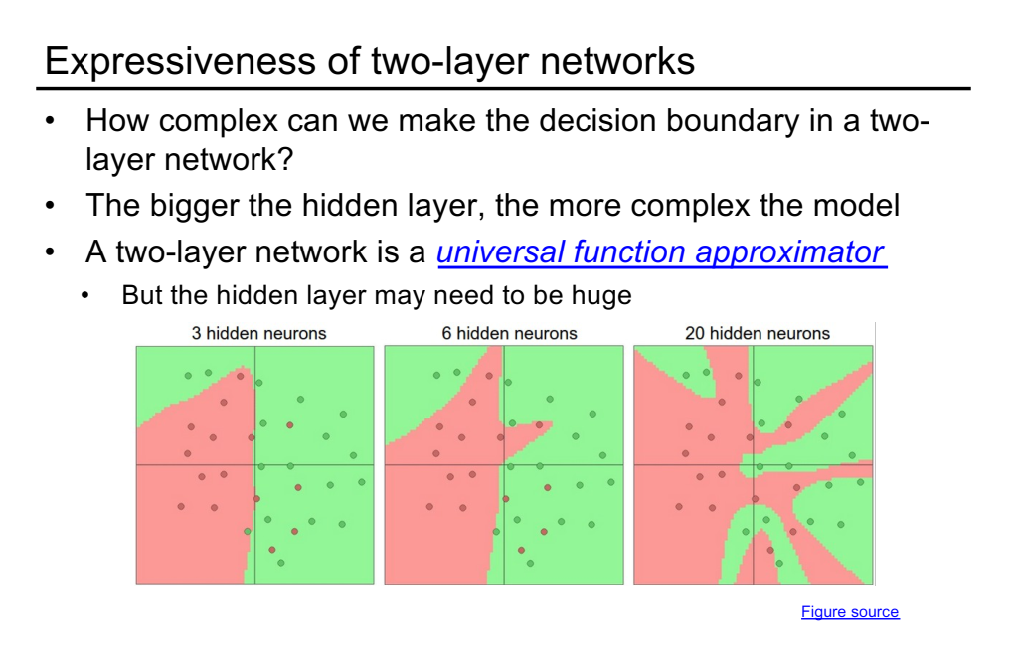

Slide 19
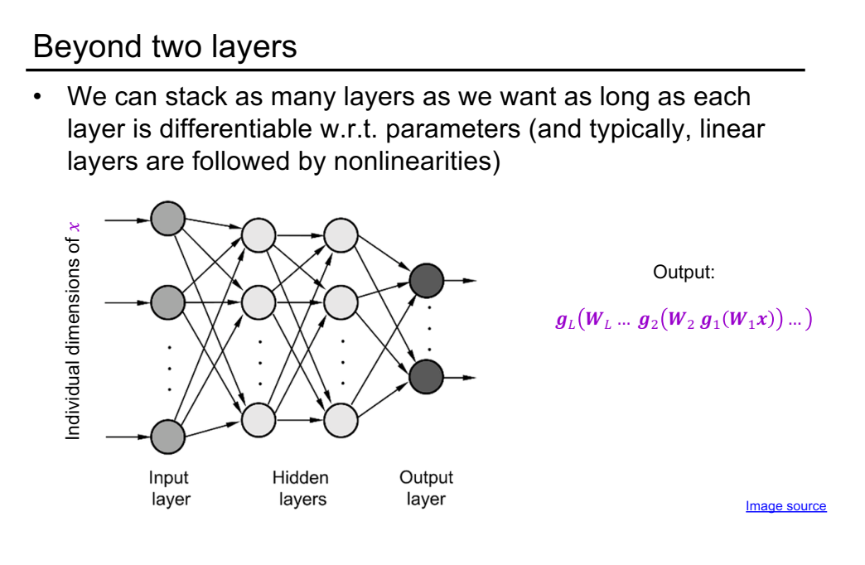

Slide 20
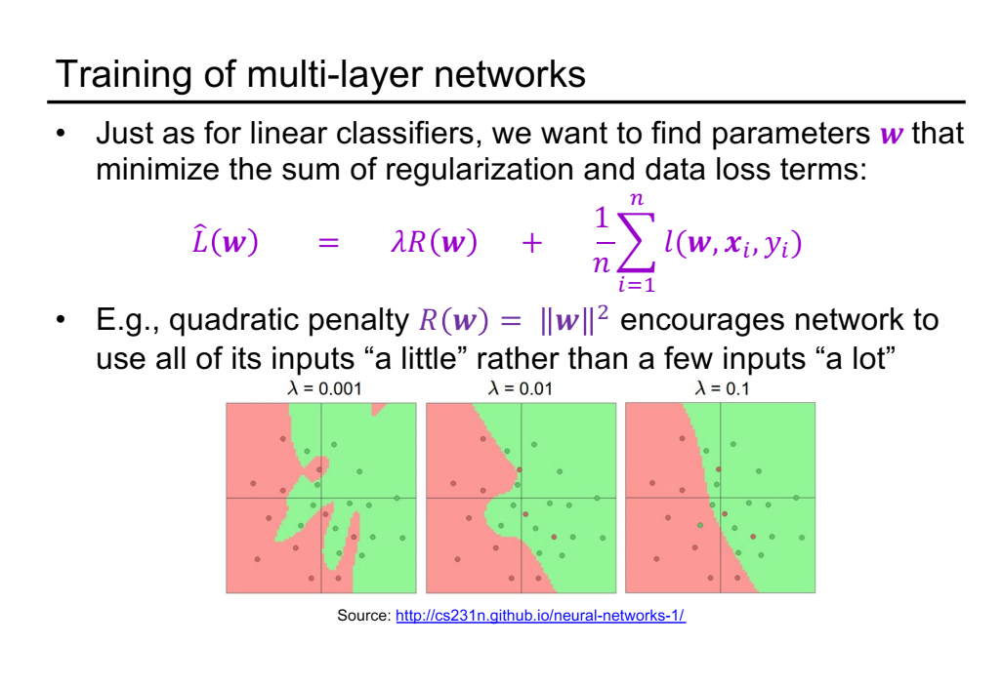

Slide 21
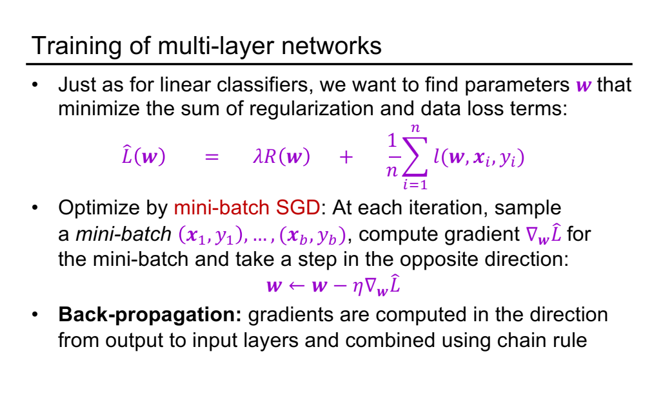

Slide 22
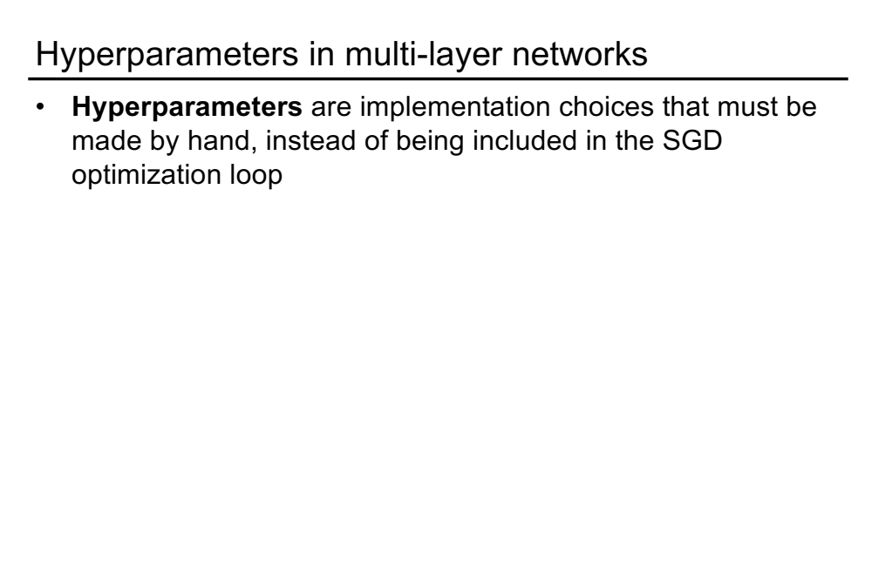

Slide 23
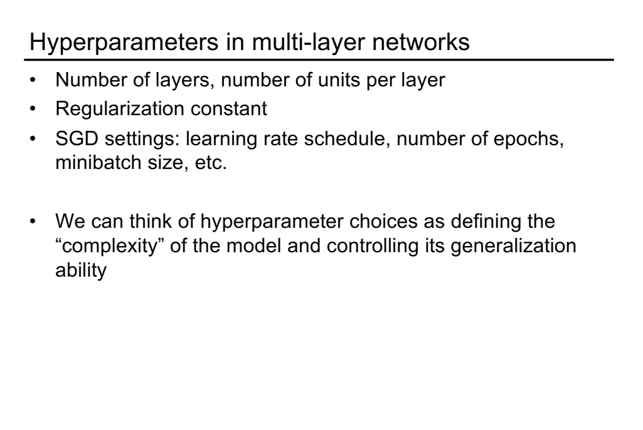

Slide 24
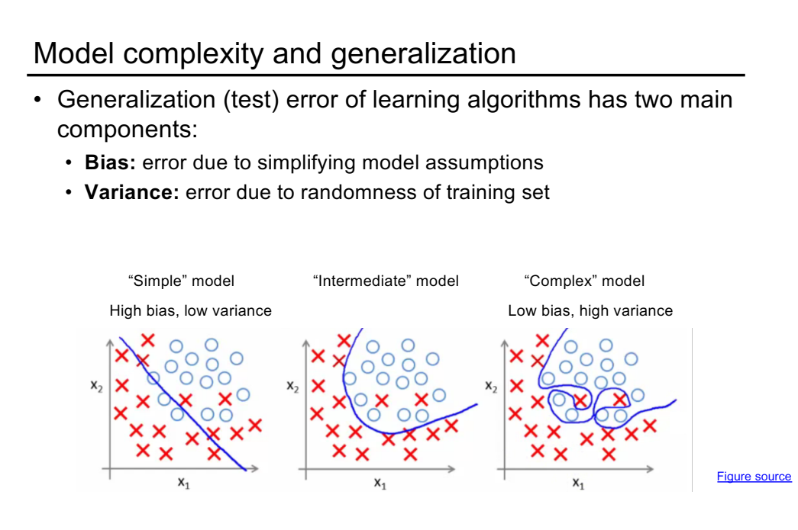

Slide 25
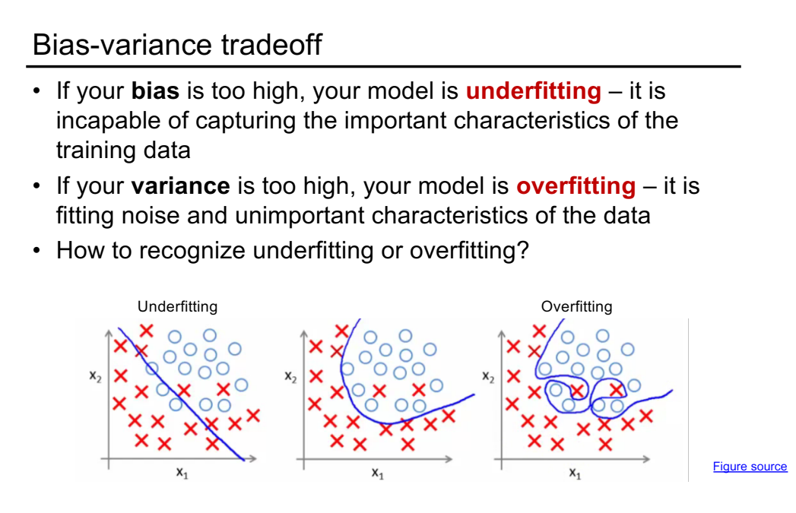

Slide 26
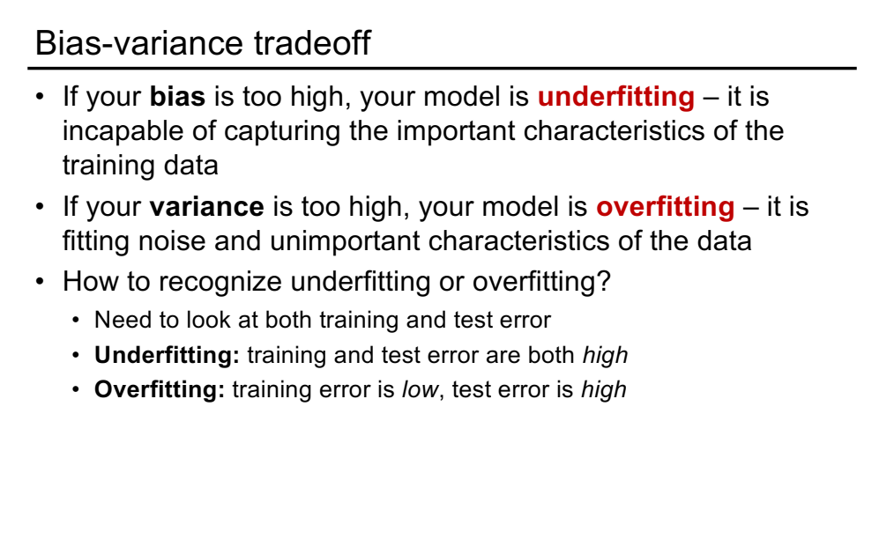

Slide 27
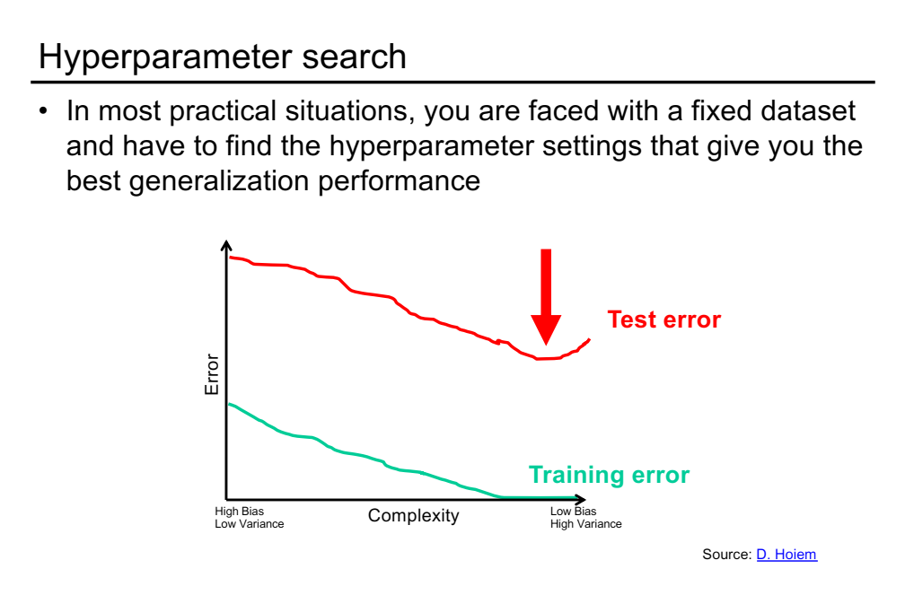

Slide 28
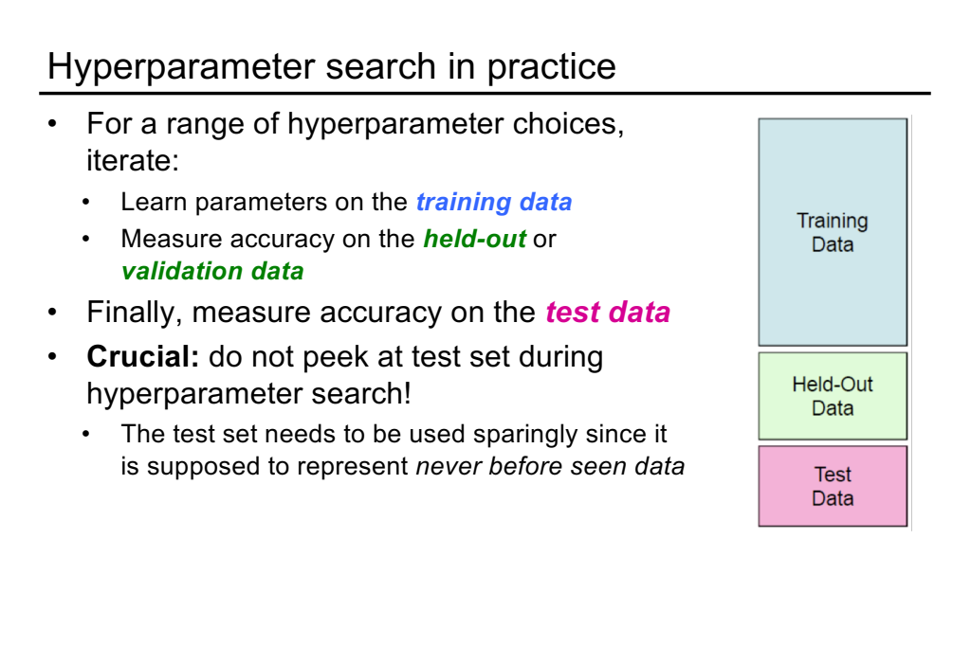

Slide 29
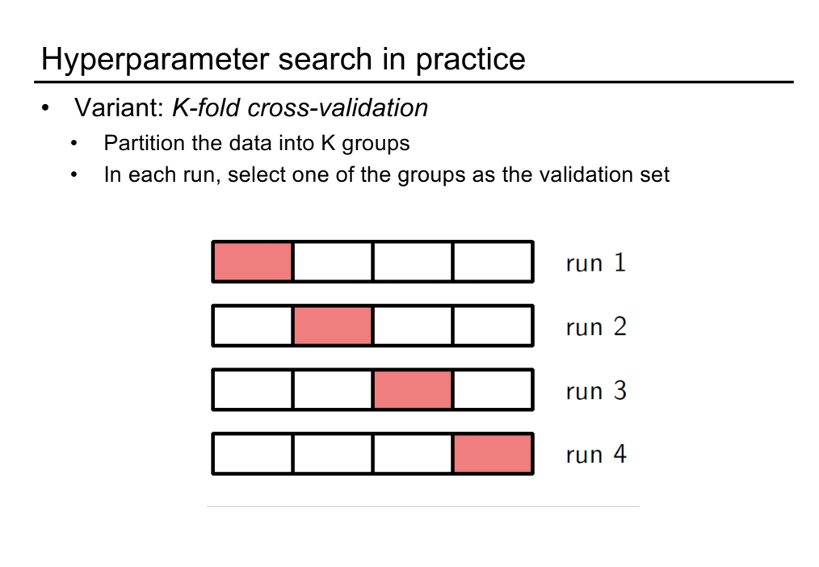

Slide 30
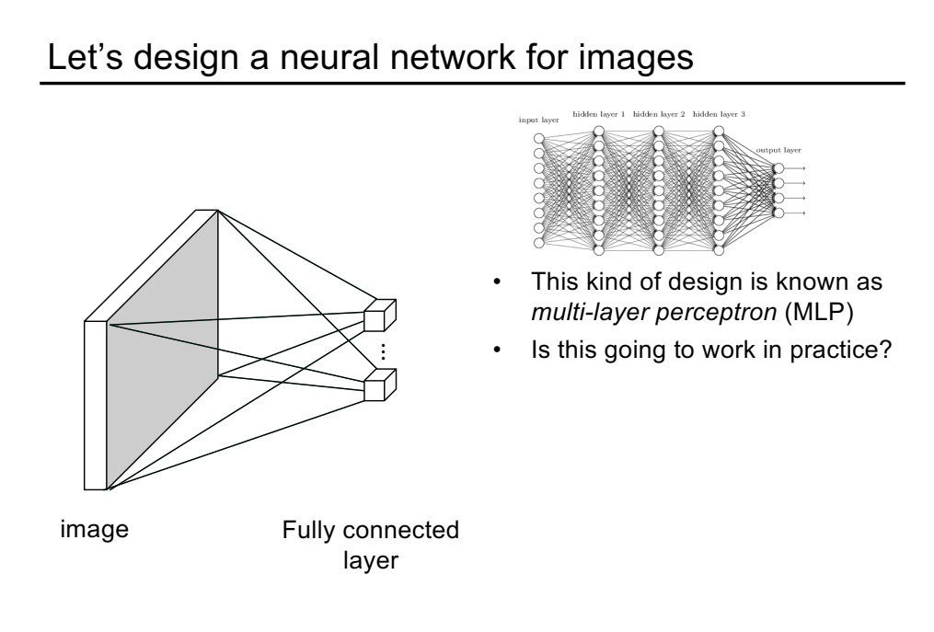

Slide 31
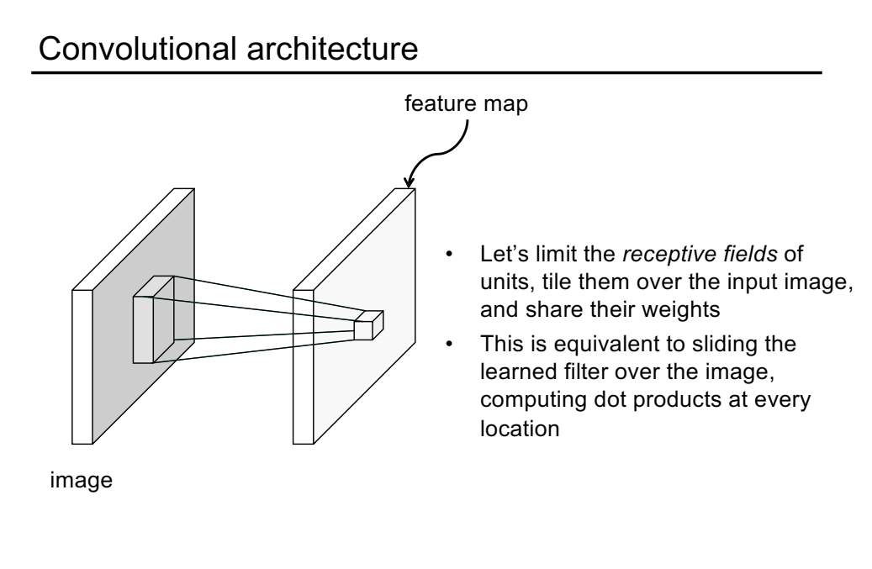

Slide 32
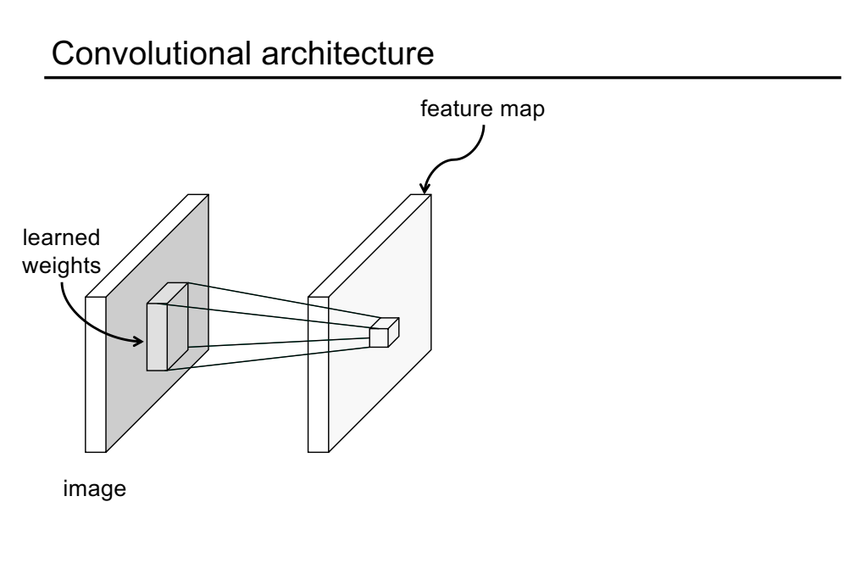

Slide 33
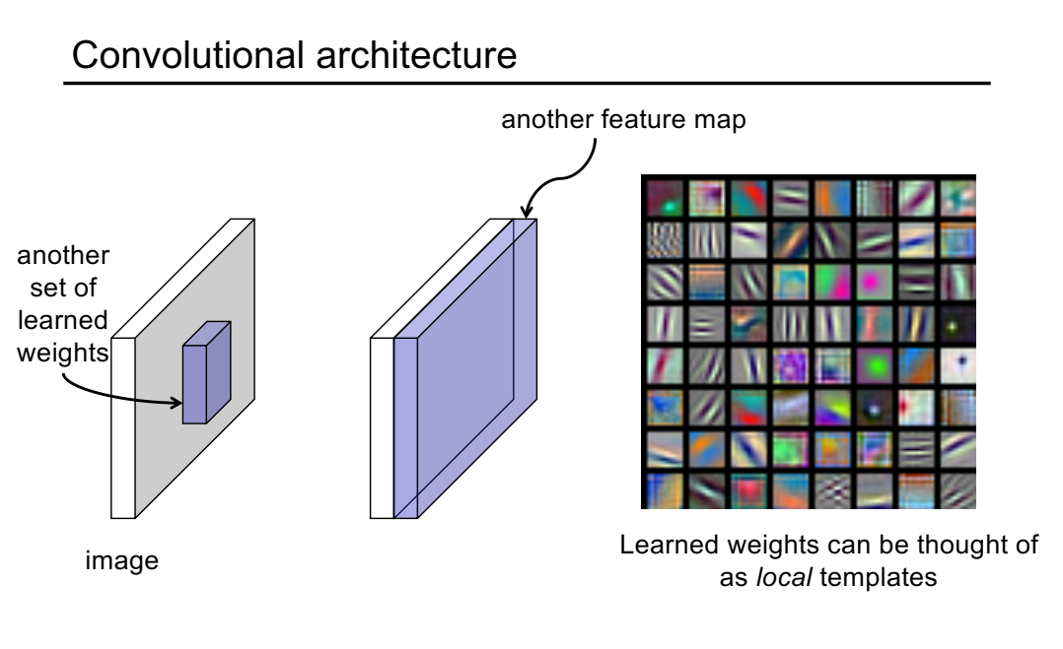

Slide 34
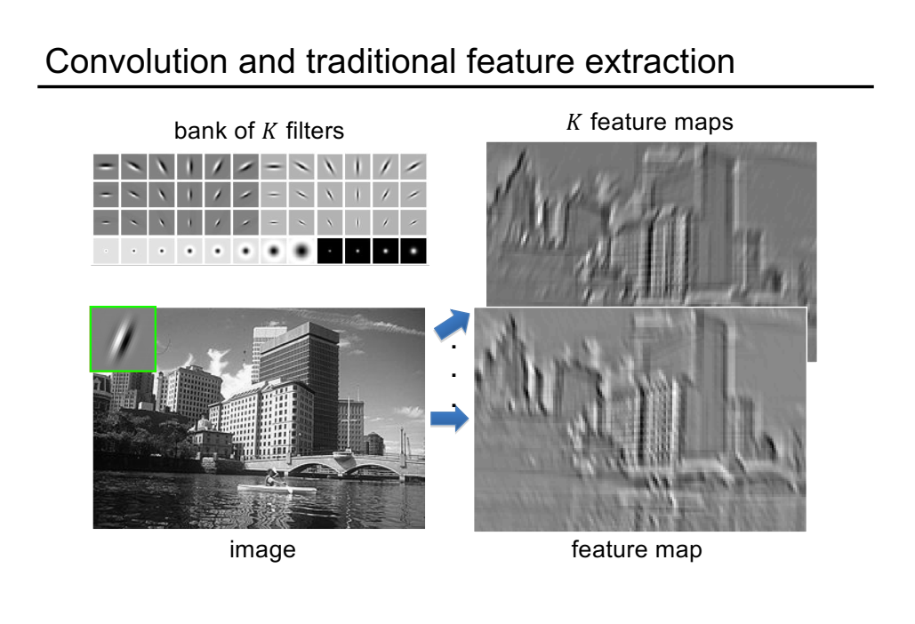

Slide 35
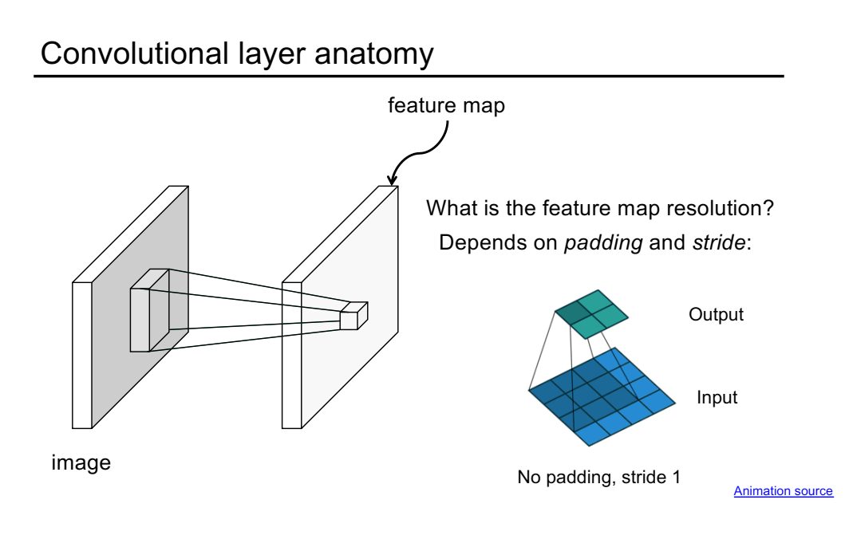

Slide 36
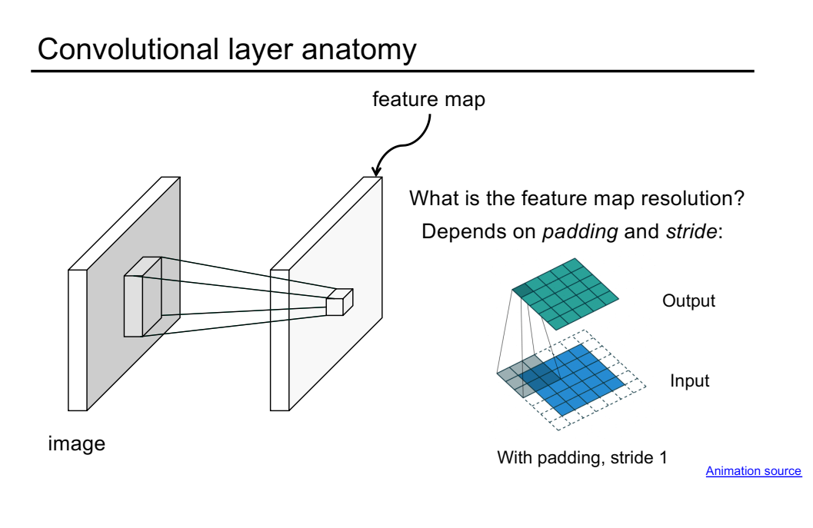

Slide 37
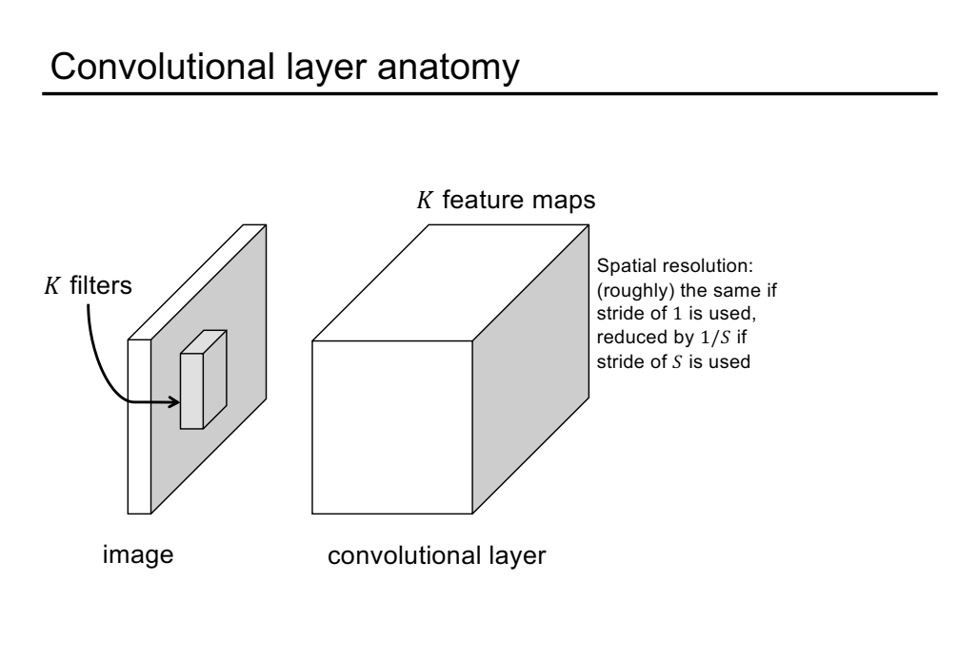

Slide 38
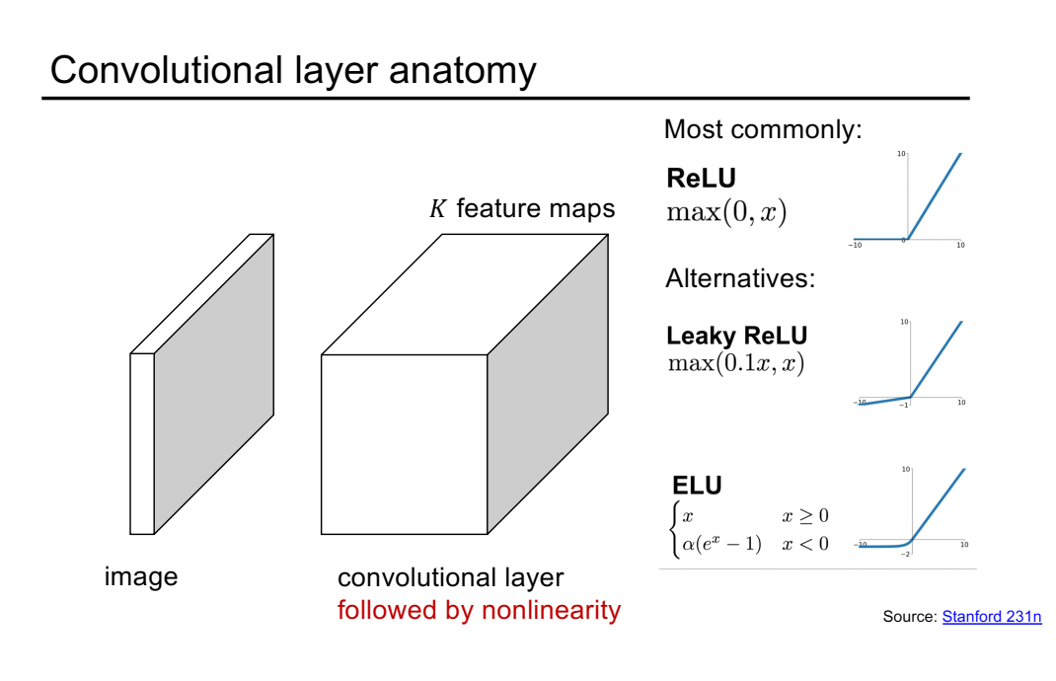

Slide 39
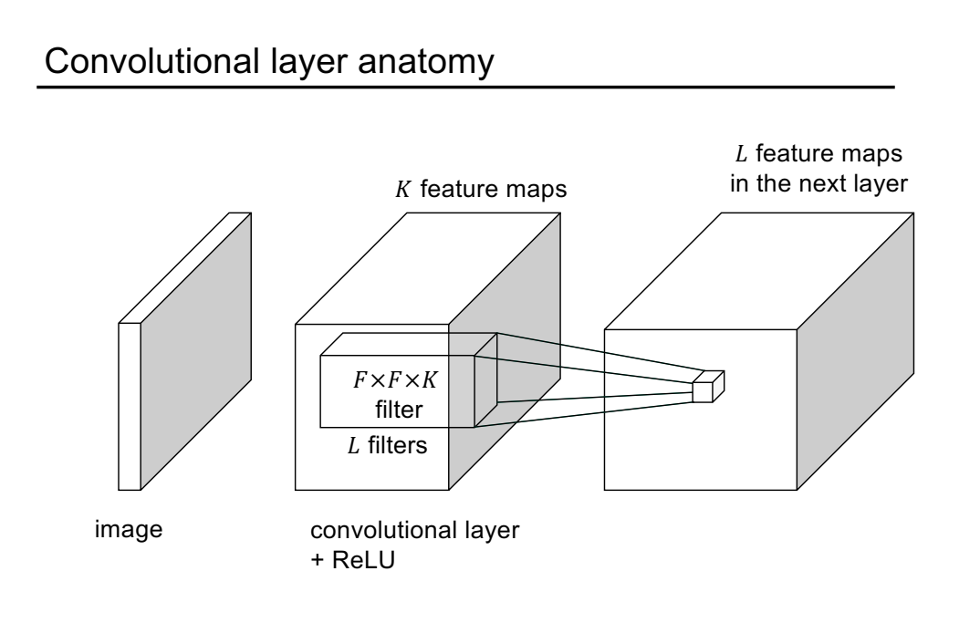

Slide 40
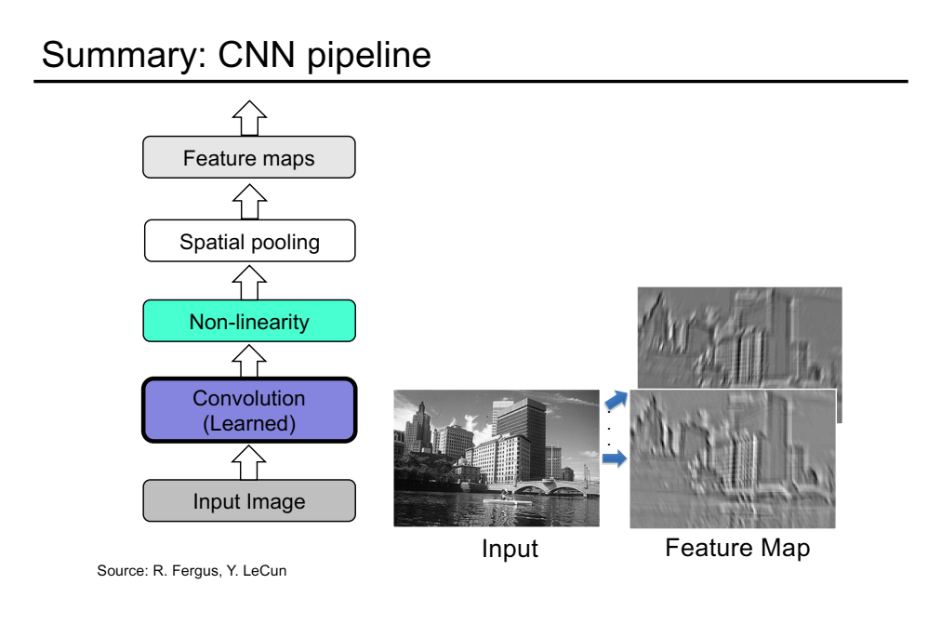

Slide 41
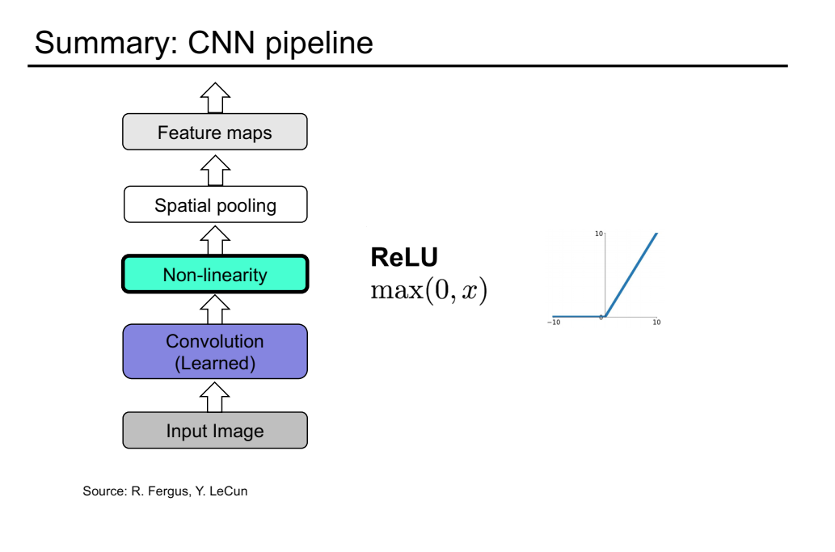

Slide 42
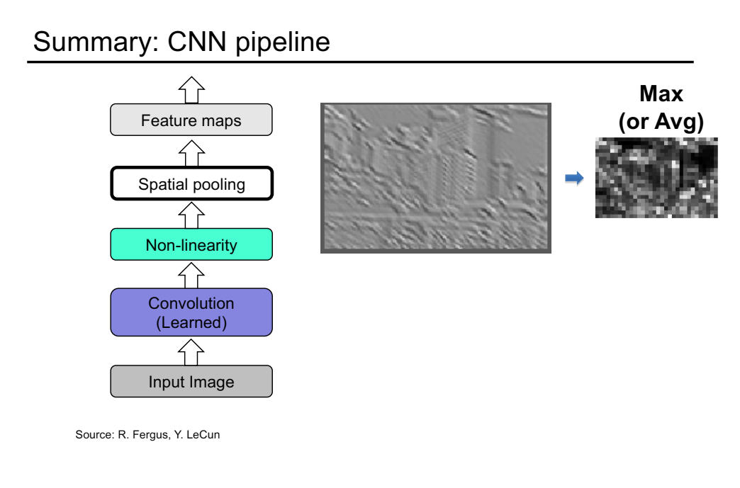

Slide 45
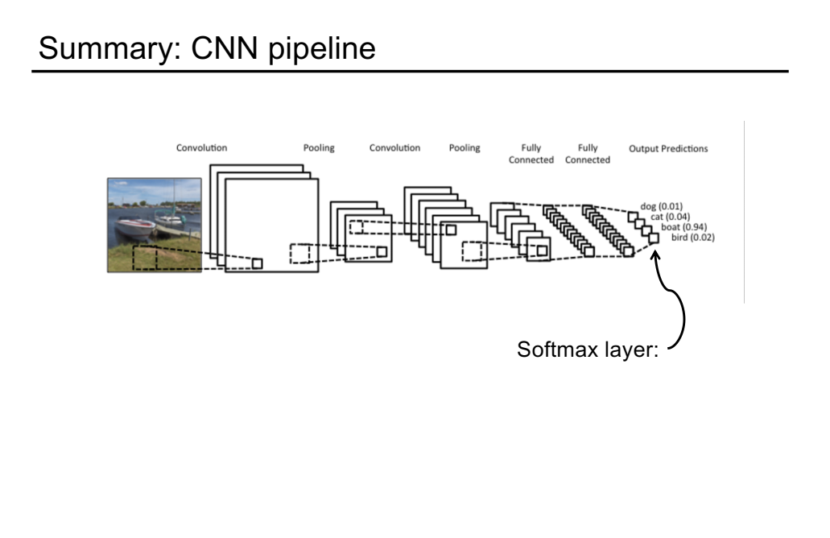

Slide 46
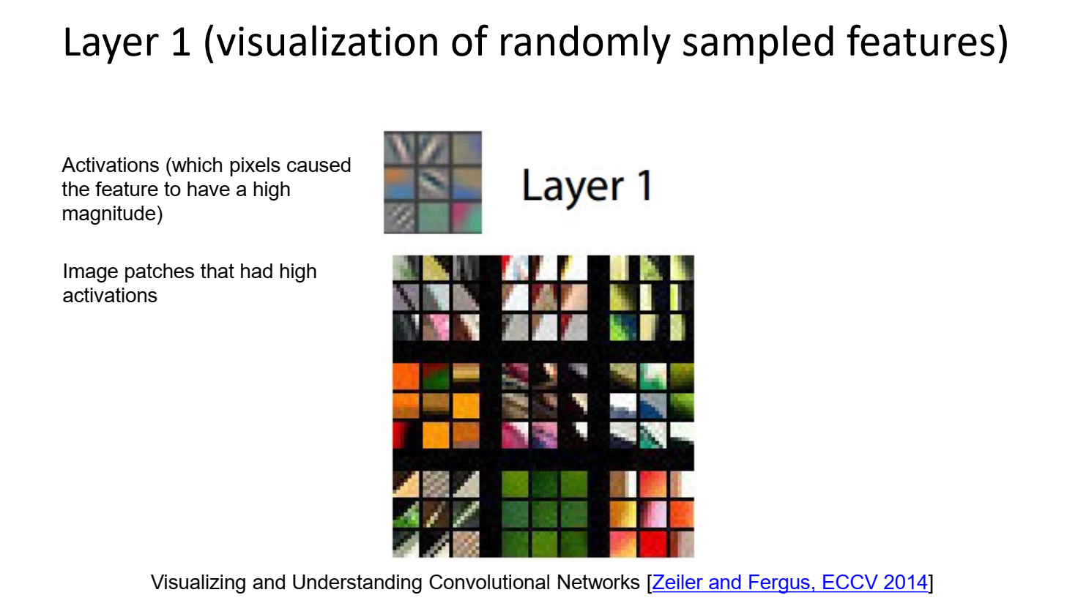

Slide 47
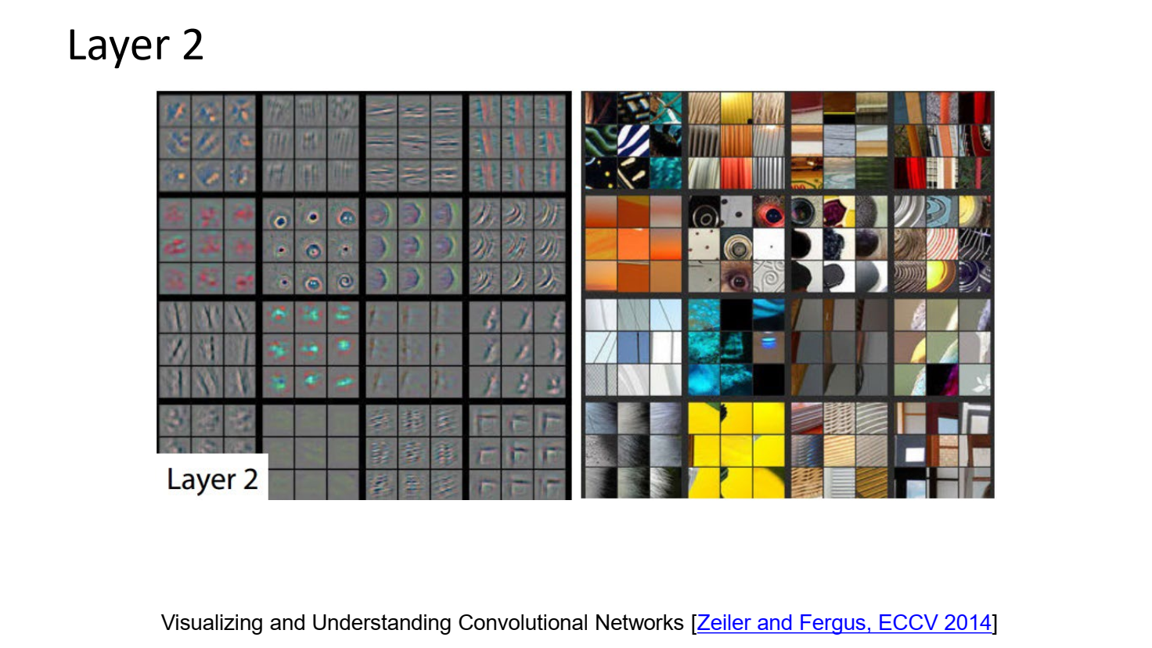

Slide 48
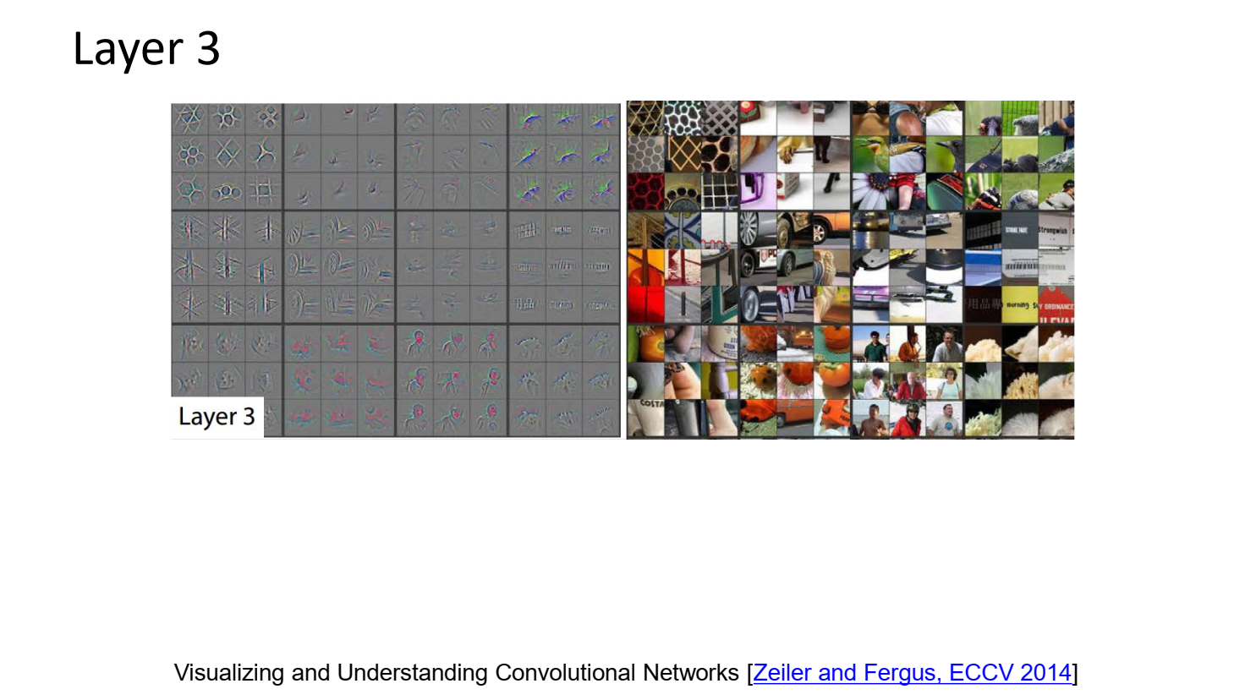

Slide 49
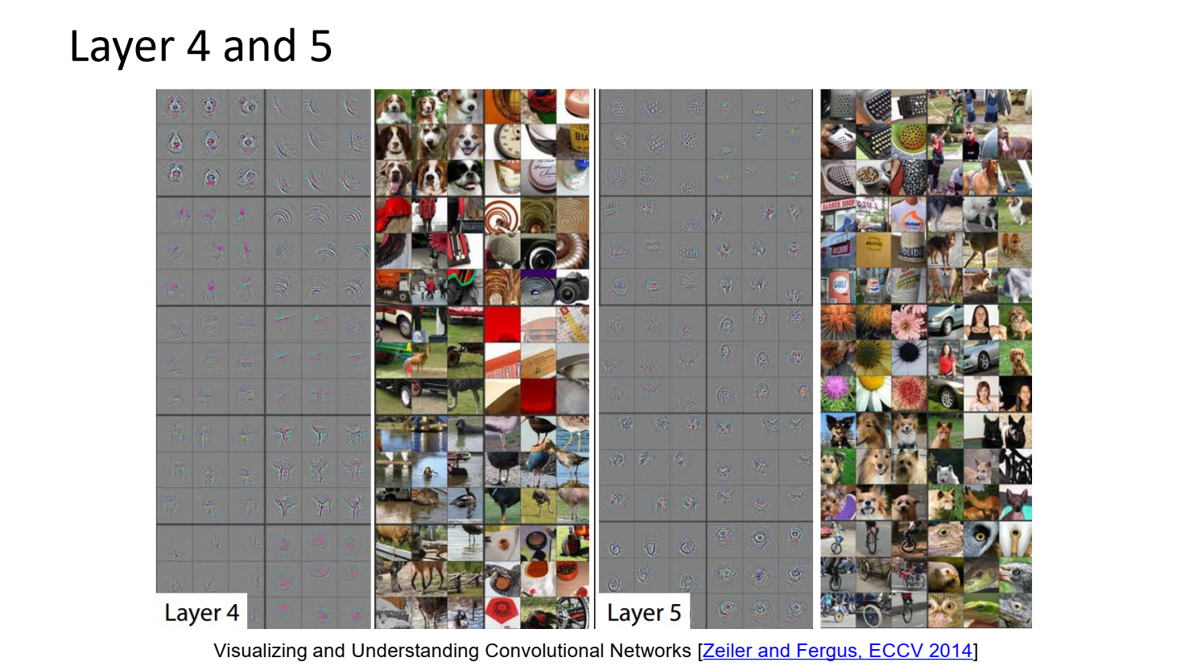

Slide 50


Slide 52


Slide 54


Slide 55


Slide 56


Slide 57


Slide 58


Slide 62


Slide 63


Slide 64


Slide 65


Slide 66


Slide 68


Slide 69


